Slide 1
QuPath Gel Annotations Tutorial
(In Progress)

Slide 2
Installation/Prep
QuPath can be installed from here: https://qupath.github.io
Then, download custom project from shared data folder: OneDrive
Save project in a permanent location, then drag-and-drop the .qpproj file into QuPath to open the project.
Download gel data, and save it in a permanent location. QuPath will not copy images but create links to their locations, so make sure their filepath does not change.

Slide 3
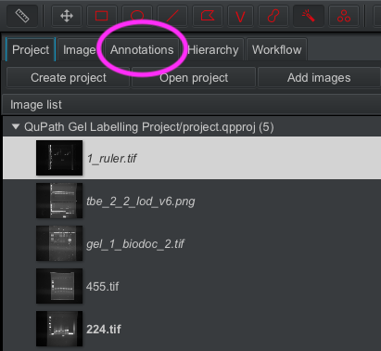

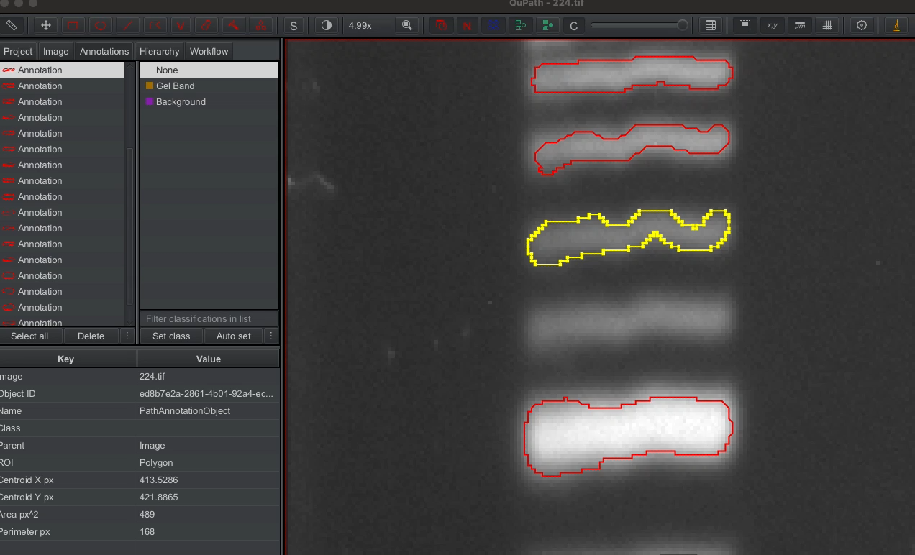
Basic Labelling
Load images by drag-and-dropping them into QuPath. Accept all defaults for any prompts that pop up, and set image type to undefined if asked.
Select ‘Annotations’ tab before doing any labelling.
Select one of the annotation types in the top-left bar. I recommend the brush tool (can edit size in preferences -> drawing tools) and wand tool (automatically fills in pixels of similar intensity).
Simply click and drag on image to label. Make sure to zoom in for small objects. To delete parts of an annotation, repeat the same operation but hold down the alt key.
Make sure to create a different annotation for each gel band.
More info from QuPath docs here: https://qupath.readthedocs.io/en/stable/docs/starting/annotating.html
Brush
Wand

Slide 4
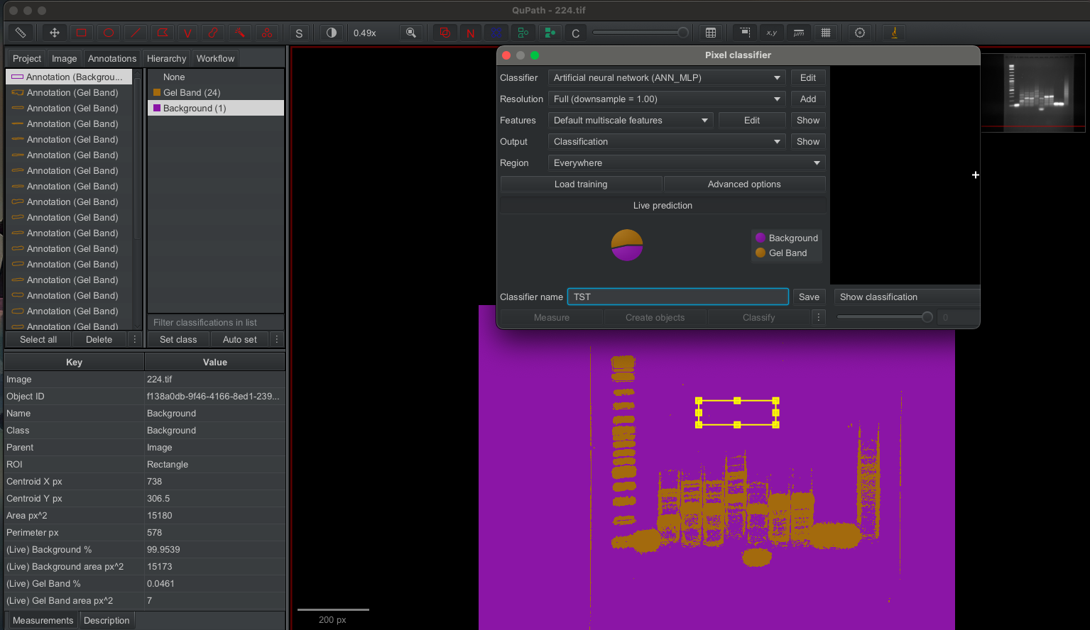
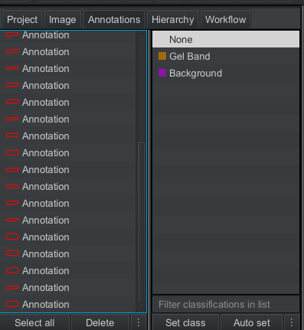
Semi-Automation with Pixel Classifier
Two options:
1) Use pre-trained pixel classifier bundled with project. Go to Classify -> Pixel Classification -> Load Pixel Classifier. Then, select the basic_455 model and click ‘create objects’. Set the parent image as ‘full image’ then click ok. This generates annotations you can edit as normal (make sure to unlock them first).
2) Train your own classifier. To do this, draw labels for some bands, and also mark a portion of the background. Click on each created annotation and assign (set class) them the ‘Gel Band’ and ’Background’ classes as necessary. Then, go to Classify -> Pixel Classification -> Train Pixel Classifier. Set the resolution to Full (downsample = 1). Click live prediction, enter a classifier name and then save. Annotations can be created using the ‘create objects’ button as before. You can mess around with the other settings if you’d like to get a slightly better result.

Slide 5
Exporting
Make sure to continuously save data. QuPath will save objects within the project folder.
For now, just zip entire project and send over to me. More specific exporting methods TBC.

